Slide 1
Tensor-Flow (1.x)
Amos Azaria

Slide 2
TensorFlow (1.x)
Open source (in Python)
Machine learning (mostly used for deep-learning)
Ubuntu, other Linux distributions, Windows or Mac +
VirtualBox / Docker (or other VM / Containerizers) or Colab
Installation, “pip install tensorflow” or see:
https://www.tensorflow.org/install/
GPU's can be 10 times faster…
Some of the code in the following slides is available also on: https://github.com/simon-pikalov/deep_learning_course_matirial

Slide 3
Constants
import tensorflow as tf will use Tensorflow 2.x
Add these two rows to use Tensorflow 1.x
>>> import tensorflow.compat.v1 as tf
>>> tf.disable_v2_behavior()
>>> a = tf.constant(3)
>>> a
<tf.Tensor 'Const:0' shape=() dtype=int32>
>>> b = tf.constant(4)
>>> c = a*b
>>> c
<tf.Tensor 'mul:0' shape=() dtype=int32>
>>> print(c)
Tensor("mul:0", shape=(), dtype=int32)
>>> sess = tf.Session()
>>> sess.run(a)
3
>>> sess.run(c)
12
In Tensoflow 2.x it will print 12
Tensorflow 2.x has no “Session”

Slide 4
Variables
>>> var1 = tf.Variable(3)
>>> var1
<tensorflow.python.ops.variables.Variable object at 0x7f41f00abd10>
>>> var2 = tf.Variable(4)
>>> c2 = var1 * var2
>>> c2
<tf.Tensor 'mul_1:0' shape=() dtype=int32>
>>> sess.run(tf.global_variables_initializer())
>>> sess.run(var1)
3
>>> sess.run(c2)
12
Notes:
Vary similar, just with variables which must be initialized

Slide 5
Simple Counting Program
>>> import tensorflow.compat.v1 as tf
>>> tf.disable_v2_behavior()
>>> x = tf.Variable(1)
>>> step = tf.constant(2)
>>> update = tf.assign(x, x+step)
>>> sess = tf.Session()
>>> sess.run(tf.global_variables_initializer())
>>> for i in range(4):
... print(sess.run(update))
3
5
7
9
>>> sess.run(update)
11
>>> sess.run(x)
11
>>> sess.run(x)
11
>>> sess.run(tf.global_variables_initializer())
>>> sess.run(x)
1
Assign returns the value after assignment (just like in Python/c/Java, where can write x=y=5)
Notes:
PS x=y=5 is not legal in Pascal, as an assignment is not an expression.

Slide 6
Data, Model, Loss, Algorithm
Data: set of x's and their true labels/values (y's).
Model Function: A function we use to get the y from the x. (We will use this function to predict the y's, when we don't have them, or during the test phase). As we will see this model may be very complex.
Loss Function: a function that determines the error which we intend to minimize.
Algorithm: The algorithm that will be used to find the minimal loss.

Slide 7
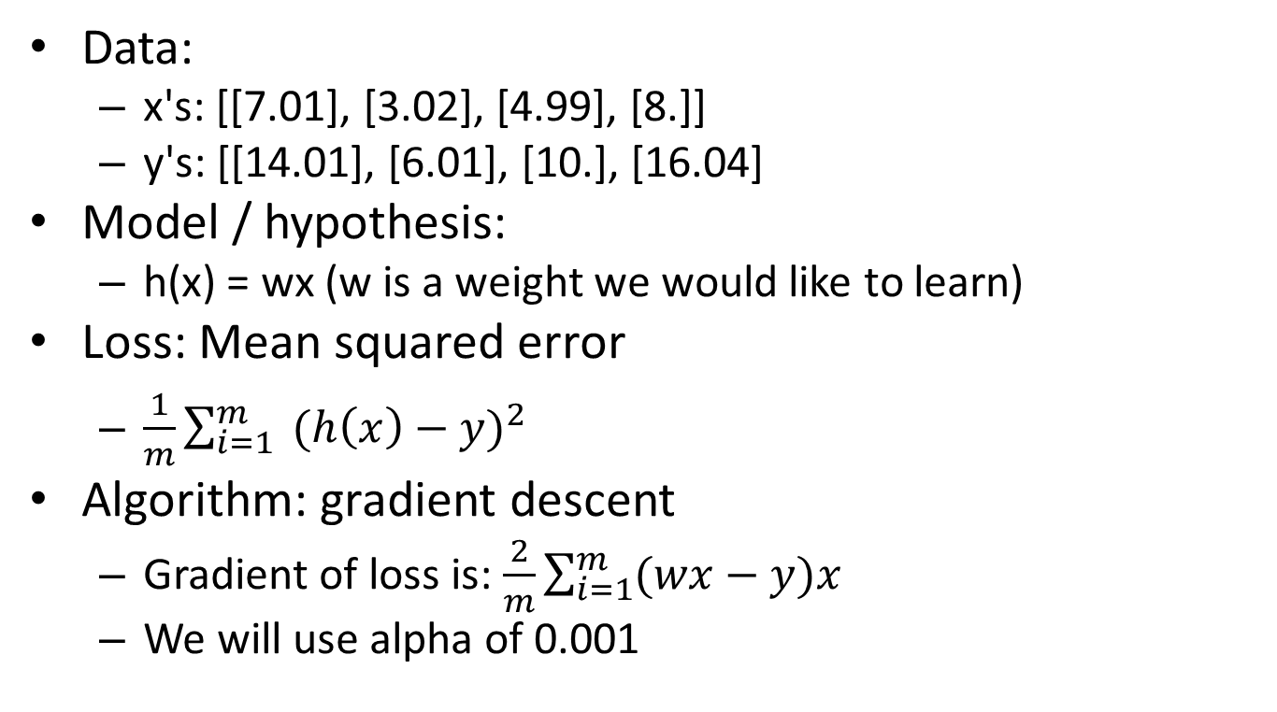
Learning What Numbers Were Noisily Multiplied by
Data:
x's: [[7.01], [3.02], [4.99], [8.]]
y's: [[14.01], [6.01], [10.], [16.04]
Model / hypothesis:
h(x) = wx (w is a weight we would like to learn)
Loss: Mean squared error
$\frac{1}{m}\sum_{i=1}^{m}{ {(h\left(x\right)−y)}^{2}}$
Algorithm: gradient descent
Gradient of loss is: $\frac{2}{m}\sum_{i=1}^{m}{(wx−y)x}$
We will use alpha of 0.001

Slide 8
Learning the Multiplying Number in TensorFlow
@tf.custom_gradient
def loss_layer(var_w, const_x, const_y):
def grad(delta):
#partial derivative according to var_w, and according to const_x, const_y (which aren't in use)
return tf.reduce_mean(2*((var_w * const_x) - const_y) * const_x * delta), None, None
return tf.reduce_mean(tf.pow(tf.multiply(var_w, const_x)- const_y, 2)), grad
x = tf.constant([[7.01], [3.02], [4.99], [8.]])
y_ = tf.constant([[14.01], [6.01], [10.], [16.04]])
w = tf.Variable(0.1) # note the dot
loss = loss_layer(w, x, y_)
grad_loss = tf.gradients(loss, w)
update = tf.train.GradientDescentOptimizer(0.001).minimize(loss)
sess = tf.Session()
sess.run(tf.global_variables_initializer())
for i in range(0, 400):
print(sess.run([w,grad_loss, loss, update]))
print(sess.run(w))
Notes:
We want to minimize the mean squared error.
This has been proven that minimizing MSE is optimal if we assume Gaussian Noise.
This slide you don't have to fully understand, but it should help you later when we use TensorFlow for Linear and Logistic Regression.
[If we don't use the dot in "m", it will assume that "m" is an integer and later fail, because it doesn't cast to float automatically.
However, the integers in "x" and "y_" will work also without the dots (they will be casted to float)]

Slide 9
Results
[0.16996607, [-69.966064], 133.05936, None] [0.23735806, [-67.392], 123.448944, None] [0.3022707, [-64.912636], 114.53267, None] [0.3647952, [-62.524494], 106.26039, None] [0.4250194, [-60.224205], 98.58559, None] [0.48302796, [-58.008553], 91.46512, None] [0.5389024, [-55.874405], 84.858925, None] [0.59272116, [-53.81878], 78.72987, None] [0.6445599, [-51.838776], 73.04352, None] [0.69449157, [-49.93162], 67.76787, None] [1.0331879, [-36.994995], 37.201614, None] [1.4700603, [-20.308489], 11.211102, None]
[1.6871599, [-12.016294], 3.9253635, None]
[1.8638432, [-5.2678113], 0.7549095, None]
[1.9601994, [-1.587449], 0.06913242, None]
[1.9937731, [-0.30508846], 0.0031659706, None]
[2.0007818, [-0.037392944], 0.00067396427, None]
[2.0016158, [-0.005534813], 0.00063679577, None]
[2.0017455, [-0.000578586], 0.0006359844, None]
[2.0017576, [-0.000114135444], 0.0006359613, None] [2.0017576, [-0.000114135444], 0.0006359613, None] [2.0017576, [-0.000114135444], 0.0006359613, None] [2.0017576, [-0.000114135444], 0.0006359613, None]

Slide 10
Let TensorFlow compute the Gradients!
x = tf.constant([7.01, 3.02, 4.99, 8.])
y_ = tf.constant([14.01, 6.01, 10., 16.04])
w = tf.Variable(0.) #note the dot
pred = w*x
loss = tf.reduce_mean(tf.pow(pred - y_, 2))
update = tf.train.GradientDescentOptimizer(0.0001).minimize(loss)
sess = tf.Session()
sess.run(tf.global_variables_initializer())
for _ in range(0,1000):
sess.run(update)
print(sess.run(w))
Result:
2.00052
Notes:
We want to minimize the mean squared error.
This has been proven that minimizing MSE is optimal if we assume Gaussian Noise.
This slide you don't have to fully understand, but it should help you later when we use TensorFlow for Linear and Logistic Regression.
[If we don't use the dot in "m", it will assume that "m" is an integer and later fail, because it doesn't cast to float automatically.
However, the integers in "x" and "y_" will work also without the dots (they will be casted to float)]

Slide 11
Same Program with PlaceHolders
x = tf.placeholder(tf.float32, [None, 1])
y_ = tf.placeholder(tf.float32, [None, 1])
w = tf.Variable(0.) #note the dot
pred = w*x
loss = tf.reduce_mean(tf.pow(pred - y_, 2))
update = tf.train.GradientDescentOptimizer(0.0001).minimize(loss)
sess = tf.Session()
sess.run(tf.global_variables_initializer())
for _ in range(0,1000):
sess.run(update, feed_dict = {x:[[7.01], [3.02], [4.99], [8.]], y_:[[14.01], [6.01], [10.], [16.04]]})
print(sess.run(w))
In Tensorflow 2.X we would define an input layer instead
Result:
2.00052

Slide 12
tensorflow.train.Saver
Training large datasets takes a while, so we would like to use the weights we have learned:
In order to make new predictions
To resume training.
A good practice is to save checkpoints every X updates.
saver = tf.train.Saver()
saver.save(sess, filename)
saver.restore(sess, filename)

Slide 13
TensorBoard
TensorBoard can help visualize the built graph along with presenting different charts
>>> tf.summary.FileWriter('./my_graph', sess.graph)
~$ tensorboard --logdir ./my_graph/
Open browser to http://0.0.0.0:6006/#graphs
Graph is clearer if you give the variables/objects names e.g.:
m = tf.Variable(0., name="multiplier")

Slide 14
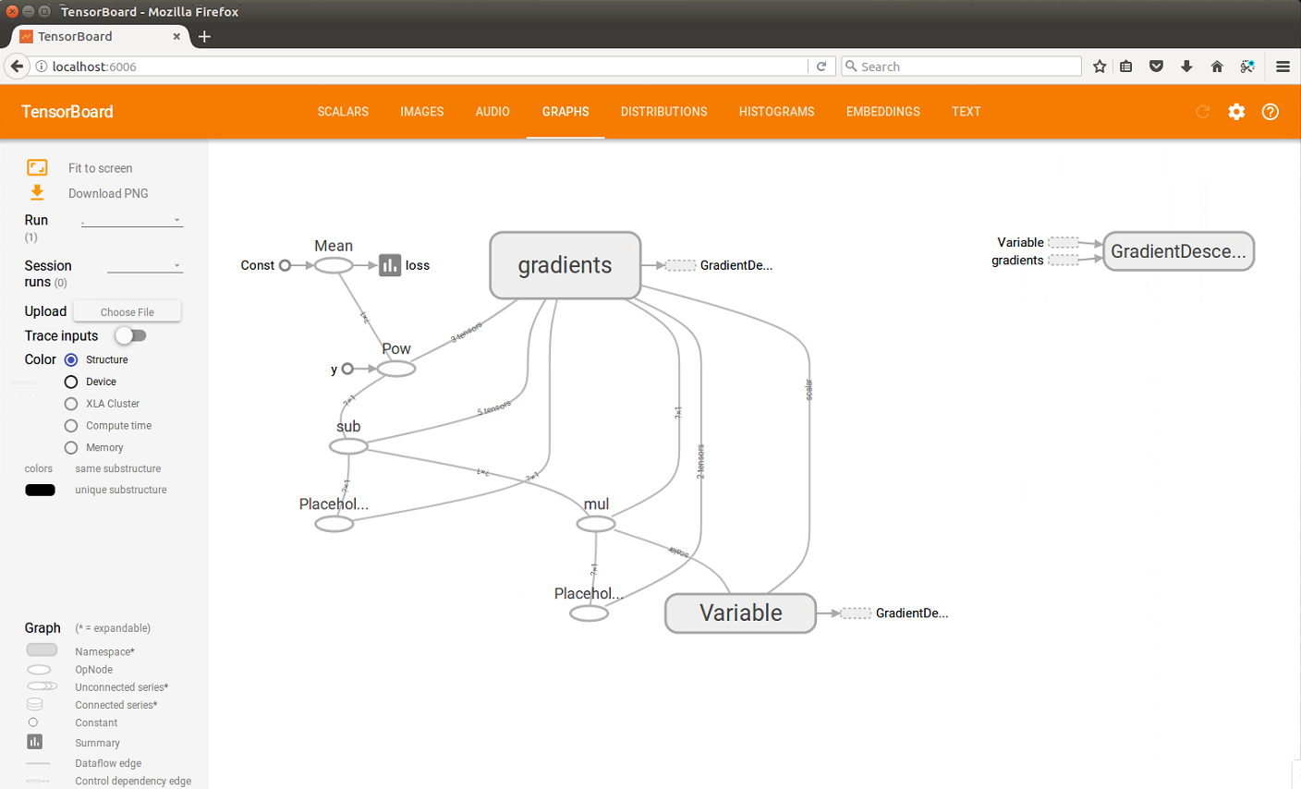
TensorBoard

Slide 15
SummaryWriter
…
msum = tf.summary.scalar('m', w)
sess = tf.Session()
file_writer = tf.summary.FileWriter('./my_graph', sess.graph)
for i in range(0,1000):
curr_sammary = sess.run(msum)
file_writer.add_summary(curr_sammary, i)
sess.run(update, …)
file_writer.close()

Slide 16
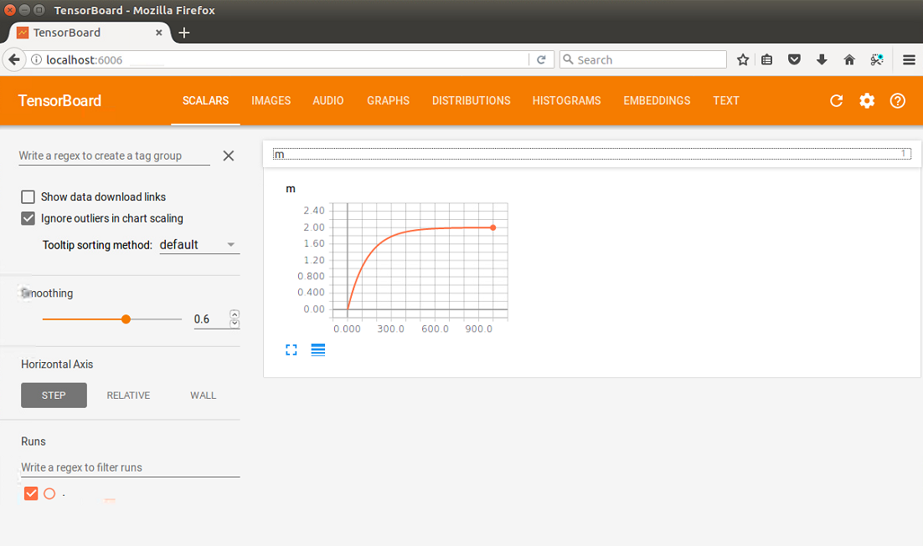
Summary Writer Graph
$ tensorboard --logdir ./my_graph/

Slide 17
Merged Summary
import tensorflow as tf
x = tf.placeholder(tf.float32, [None, 1])
y_ = tf.placeholder(tf.float32, [None, 1])
w = tf.Variable(0.)
y = w*x
loss = tf.reduce_mean(tf.pow(y - y_, 2))
update = tf.train.GradientDescentOptimizer(0.0001).minimize(loss)
msum = tf.summary.scalar('m', w)
losssum = tf.summary.scalar('loss', loss)
merged = tf.summary.merge_all()
sess = tf.Session()
file_writer = tf.summary.FileWriter('./my_graph', sess.graph)
sess.run(tf.global_variables_initializer())
data_dict = {x:[[7.01], [3.02], [4.99], [8.]], y_:[[14.01], [6.01], [10.], [16.04]]}
for i in range(0,1000):
[_,curr_sammary] = sess.run([update,merged], feed_dict = data_dict)
file_writer.add_summary(curr_sammary, i)
file_writer.close()
print(sess.run(m))

Slide 18
